Slide 1
How to Claim Reimbursement for Your Juvenile Justice Center Telephone Fees: A Step-By-Step Tutorial

Slide 2
Background
COVID19 Pandemic severely restricted in-person visitation at juvenile facilities
Telephone communications are a critical link between youth and their families that preserves family unity and reduces negative health outcomes and behavioral challenges
ACPD recognized that telephone fees incurred at the Juvenile Justice Center (JJC) – Juvenile Hall or Camp Wilmont Sweeney – can be prohibitively expensive
ACPD is now providing ALL telephone calls from the JJC FREE OF CHARGE
ACPD is also REIMBURSING youth and their families for telephone user fees paid between March 17, 2020 and September 20, 2022

Slide 3
Accessing the Claim Form
You can access the Telephone Fee Reimbursement Claim Form here:
https://probation.acgov.org/probation-assets/files/Telephone%20Fee%20Claim%20Form.pdf
Please print the form so you can fill it out and return it by mail.
If you have any questions or need assistance, please call 510-268-7124 or send an email probationfiscalgroup7691@acgovt.onmicrosoft.com.

Slide 4
What You Need to Submit a Claim
We will need TWO items from you to submit a successful reimbursement claim
A Completed Claim Form
Proof of Payment or Justification for the Amount Claimed

Slide 5
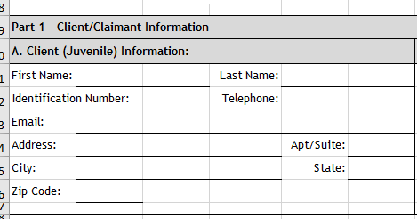
Completing the Claim Form
Part 1, Section A
Enter Client/Youth Information in Section A

Slide 6
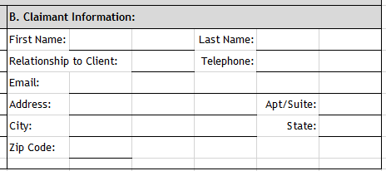
Completing the Claim Form
Part 1, Section B
Enter Claimant Information in Section B. The Claimant can be the family member or the youth that paid for the telephone fees

Slide 7
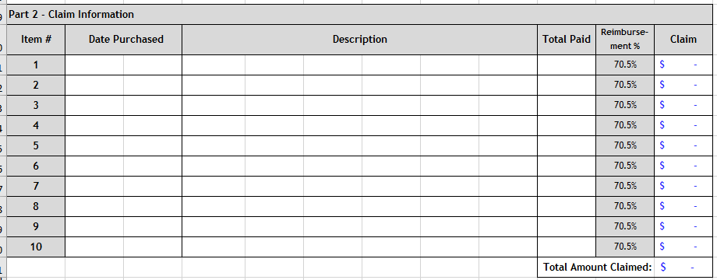
Completing the Claim Form
Part 2 Details of Telephone Payments
Enter the details of the telephone payments made including date of purchase or calls, description and amount paid
Multiply by 70% to get the claim amount.

Slide 8
Completing the Claim Form
Part 3 Certification
Once you complete all sections, please have the youth and claimant sign

Slide 9
Submitting the Form
Upon completion of the Claim Form, attach copies of proof of payment or justification for the cost of telephone calls being claimed. This can be any documentation that can show GTL Telephone costs were paid.
Submit the Claim Form by mail to
Alameda County Probation Department
P.O. Box 2059
1111 Jackson Street, Suite 805
Oakland, CA 94604-2067
ATTN: Telephone Fees Reimbursement

Slide 10
Contact Info & Questions
You can access the Telephone Fee Reimbursement Claim Form here:
https://probation.acgov.org/probation-assets/files/Telephone%20Fee%20Claim%20Form.pdf
If you have any questions or need assistance, please call 510-268-7124 or send an email probationfiscalgroup7691@acgovt.onmicrosoft.com.

Slide 11
Thank You!

